Slide 1
WEB TECHNLOGY LAB 2017-2018 LAB PROJECT WORK
GROUP -
ROLL NO-15/IT/34
ROLL NO-15/IT/11
ROLL NO-15/IT/81

Slide 2
DATE-24/01/17 PROJECT WORK FOR WEB TECHNOLOGY LAB
There will be webpages for two types of accounts . One for the administrator and other for the users. Two separate login system needed to be created.
Administrator is having the right to access the student databases, add new students data, delete any student data or update the same.
User/student need to register first by filling up a standard registration form with the field like name, age, roll no., branch ,address , phone no. etc. The registration request should go to administrator .Upon acceptance of request , the account will be activated.

Slide 3
WEBSITE LAYOUT
Website will contain a introduction web page which will provide the details about the project and there will be a navigation bar which will contain links to student portal and admin’s portal.
The website will have mainly 2 parts-
1- Student login/signup portion.
2- Administrator login portal.

Slide 4
STUDENT PORTAL-
In student portal there will be 2 different kind of forms available .
A form will be available for the new students to register and enter various information about themselves. This form will contain fields like name, age, roll no., branch ,address , phone no. etc. Students will fill this form and send a request to the administrator for creation of account.
Another form will be available for those students who already have been registered in the database.
These forms will be made using html , styled using css and will be validated using javascript.
The data of the forms will be sent to the administrator file which will be a background script(php). Where it will be saved in the database.

Slide 5
2-ADMIN PORTAL
Admin’s portal will be responsible for managing database and acknowledging requests from the users.
Admin’s portal will have two parts-
a)- logging in administrator.
b)- Managing request from users, manging database.

Slide 6
2.A ADMINISTRATORS LOGIN
This part of administrator portal will contain a form which will have fields of username and password which the administrator will use to login into the database and connect to the database.
This form will be made using html and will send data to another page which will connect to the database and provide the database control to the administrator.

Slide 7
2.B DATABASE CONTROL-
This portion of the website will deal with the actual problems which will help our website’s functioning.
This potion will help in connecting to the database and act as the backend script.
This backend script will prevent sql injection and help in establishing , updating or deleting a user.

Slide 8
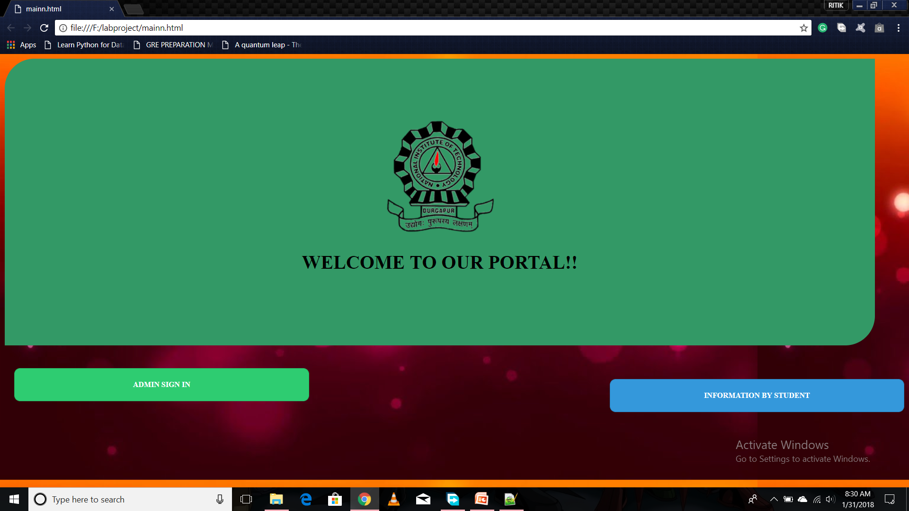
DATE-31/01/18 MAIN PAGE OF THE PORTAL
THIS PAGE WILL CONTAIN TWO LINKS
1- FIRST LINK WILL BE TO THE ADMIN SIGNUP PORTAL
2- SECOND LINK WILL BE TO THE STUDENT INFORMATION PORTAL.

Slide 9
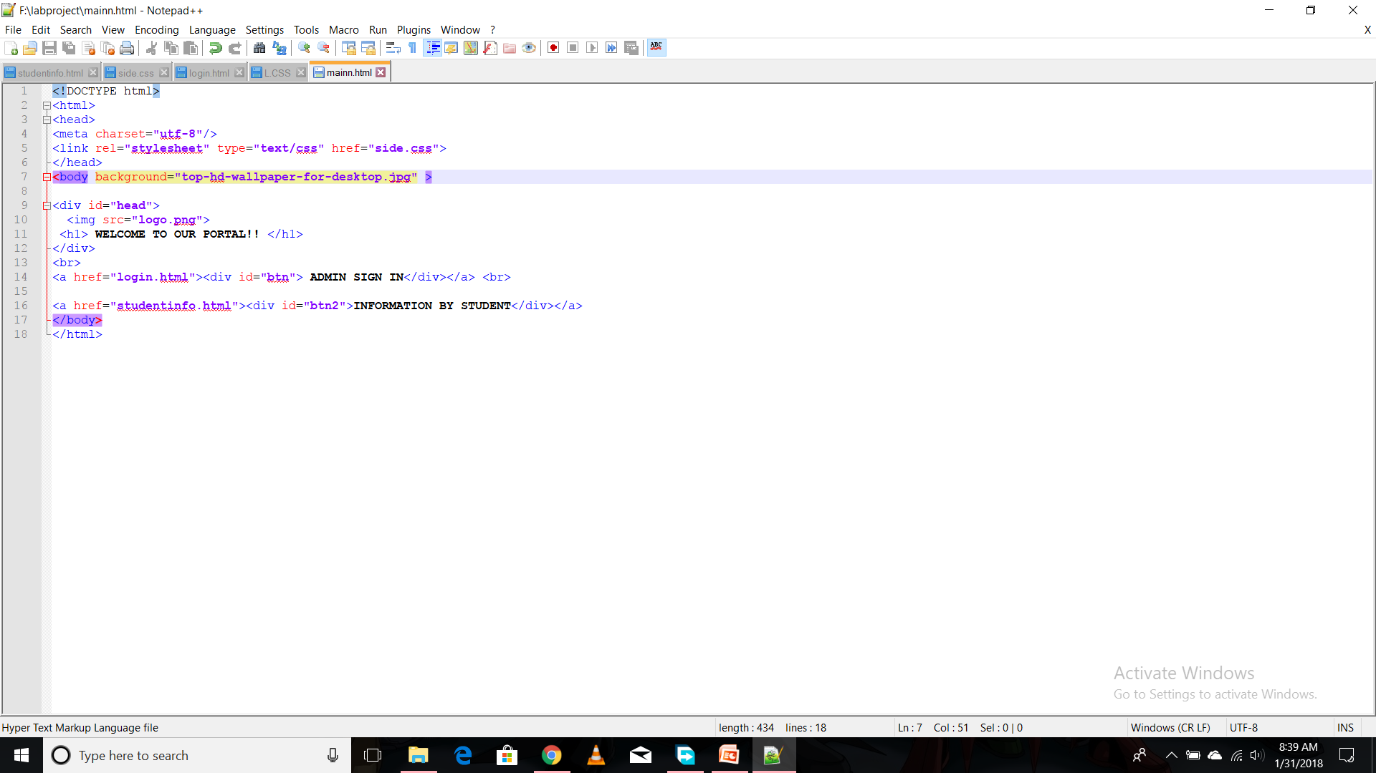
CODE-

Slide 10
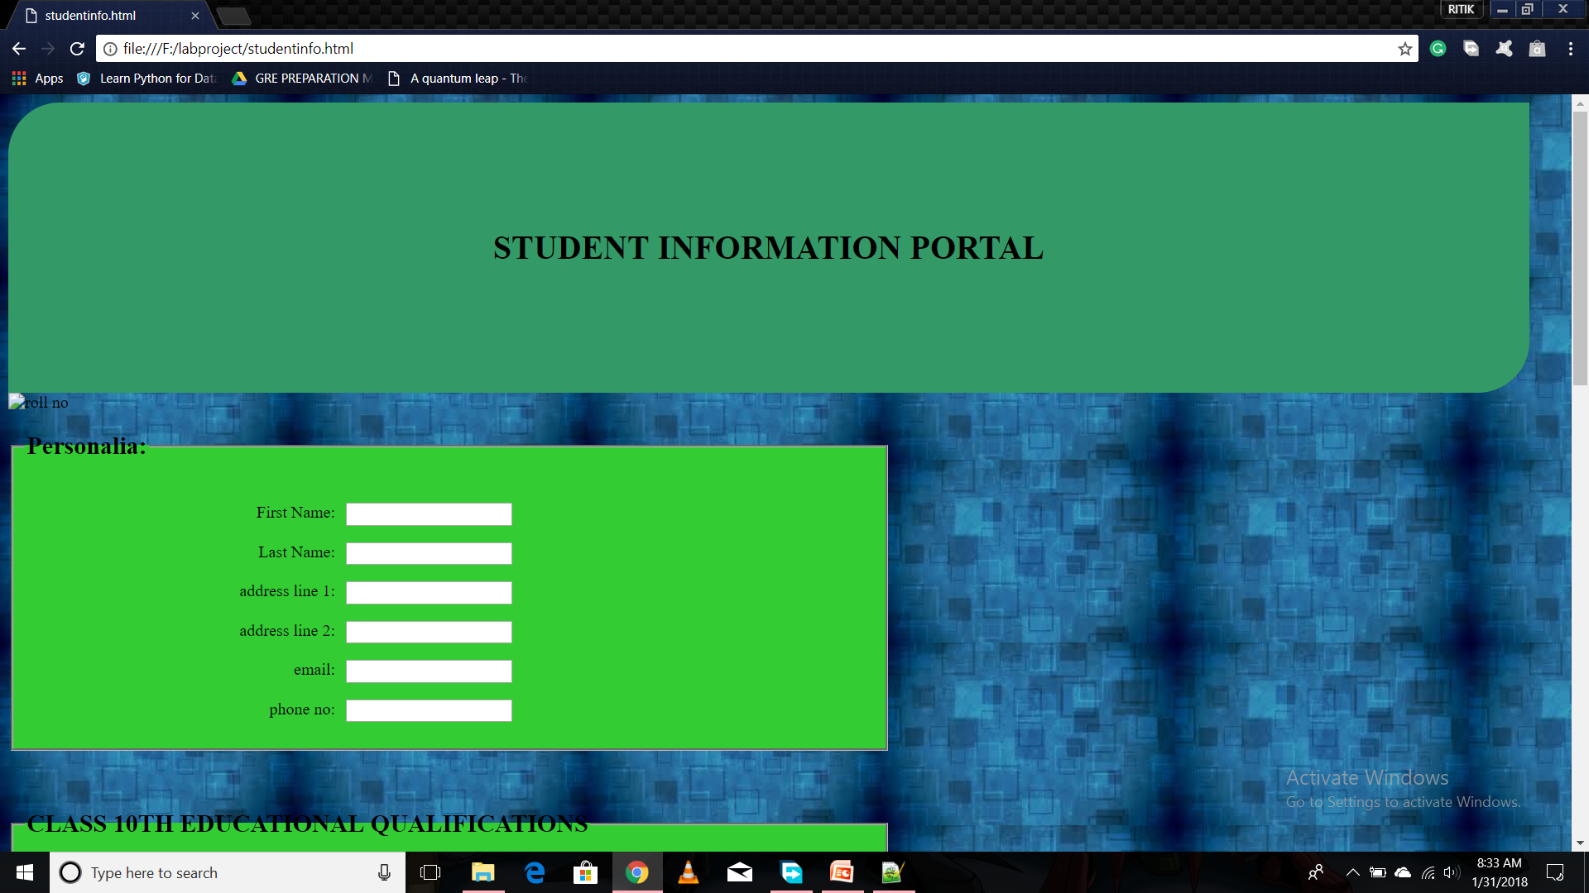
STUDENT INFORMATION PORTAL DATE-31/01/18
THIS PART OF PORTAL WILL CONTAIN A FORM WITH VARIOUS FIELDS WHICH IS TO BE FILLED BY THE STUDENT.

Slide 11
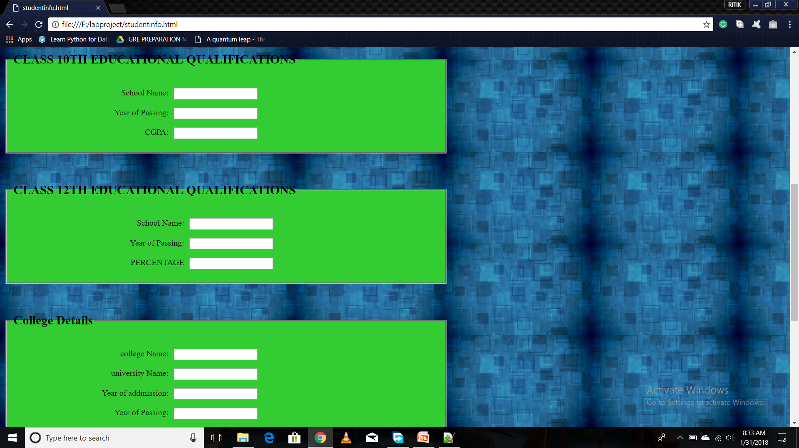
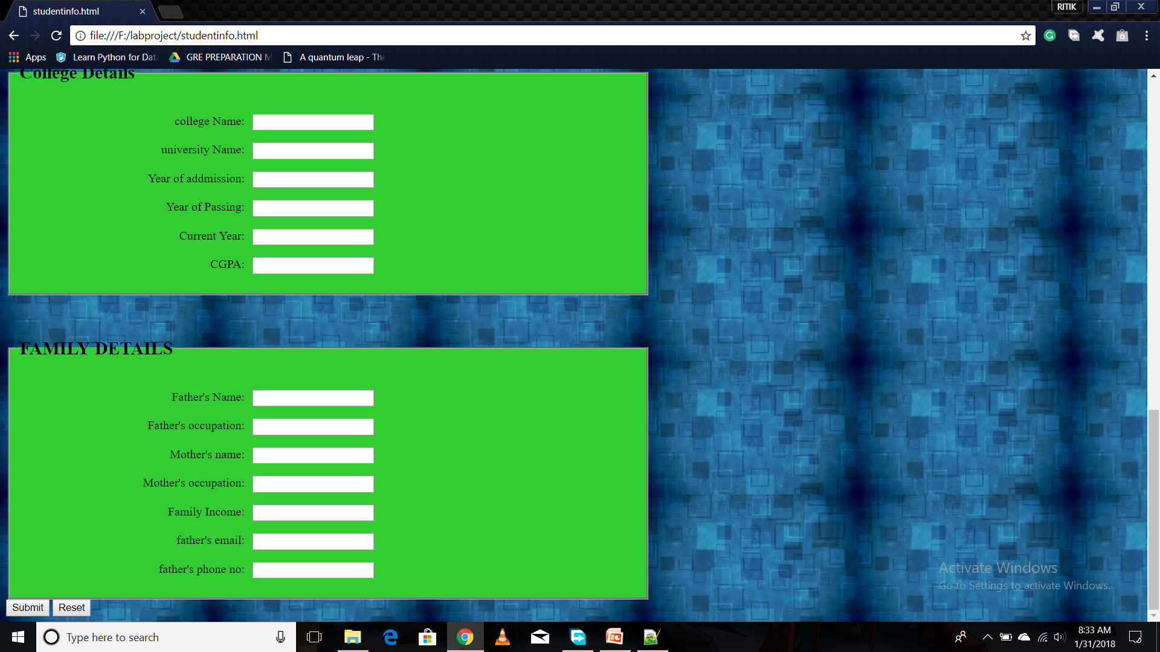
STUDENT PORTAL-
THE FORM WILL HAVE VARIOUS TYPES OF FIELD.

Slide 12
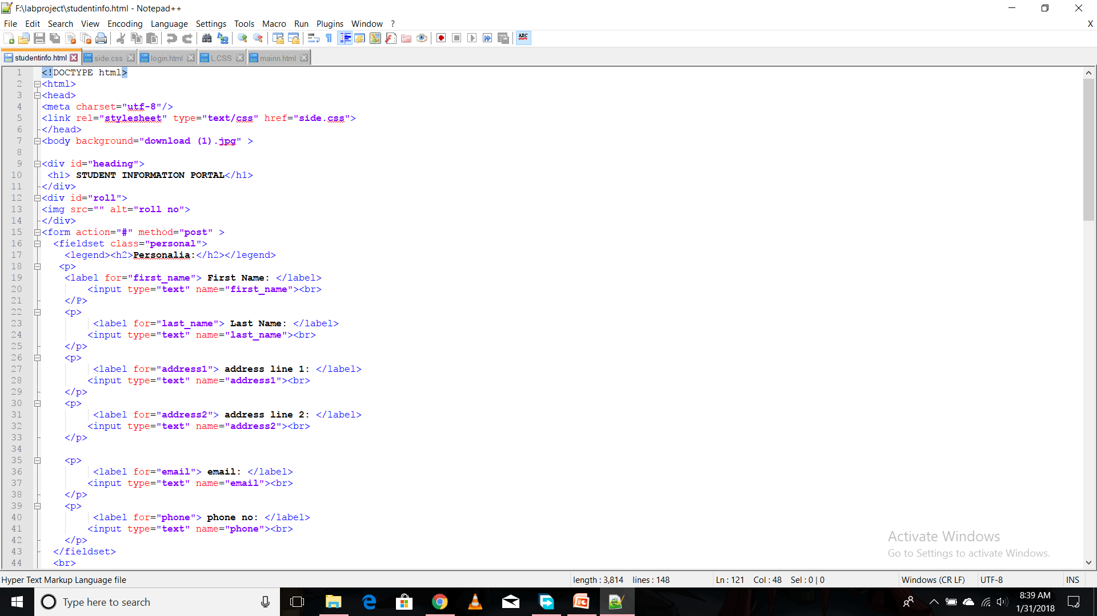
CODE-

Slide 13
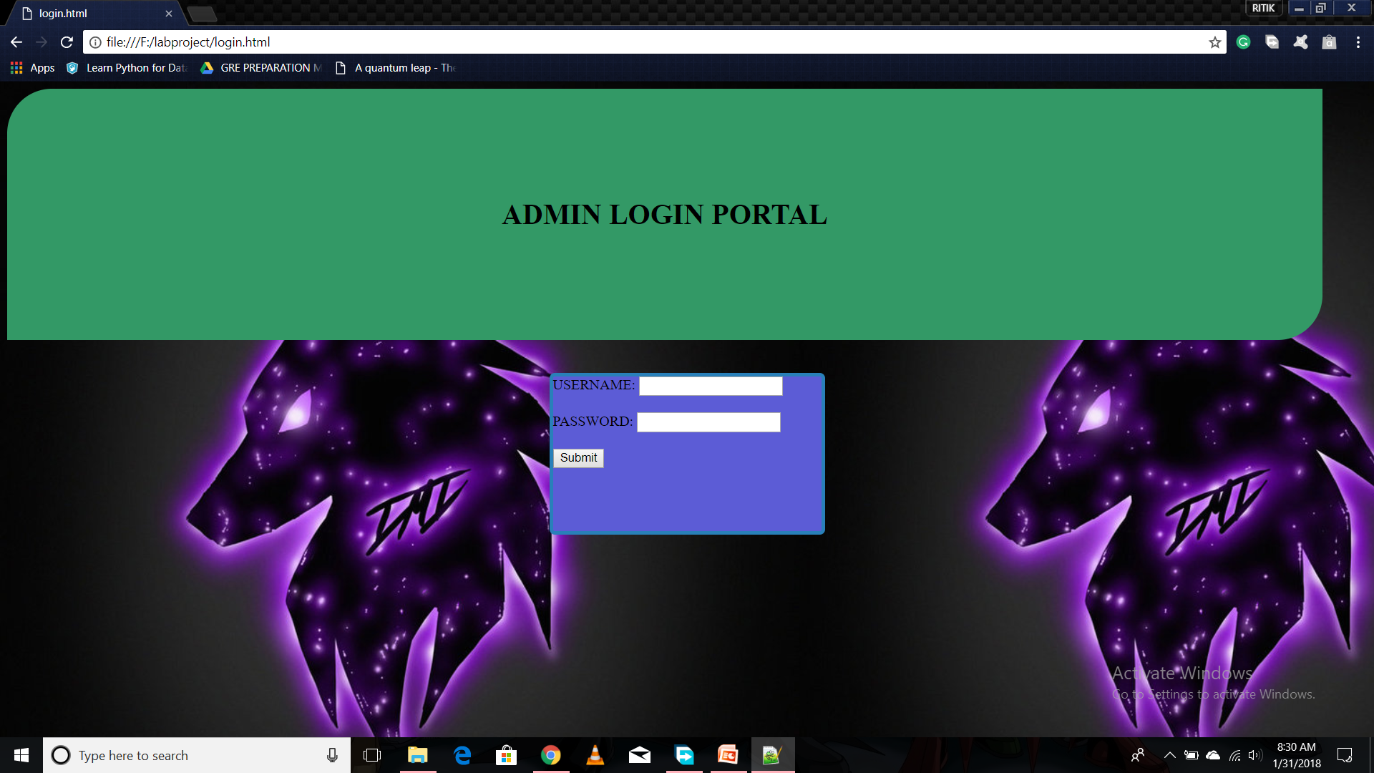
ADMINISTRATOR SIGN IN PORTAL
THIS PORTAL WILL HAVE A SIGN IN FORM FO ADMIN.

Slide 14
NEXT ASSIGNMENT-
WE WILL TRY MAKING THE CSS OF OUR PORTAL MORE RESPONSIVE AND BETTER REPRESTIVE.
WE WILL ADD JAVASCRIPT FOR VARIOUS ADDITIONAL FUNCTIONALITIES .
WE WILL DESIGN A SIMPLE BACKEND SCRIPT JUST TO RECEIVE DATA FOR SHOWING VARIOUS FEATURES OF GET ANDPOST.

Slide 15
DATE-7/2/18 POINTED OUT SUGGESTIONS
INTRODUCING A NAVIGATION BAR FOR NAVIGATING BETWEEN VARIOUS PAGES.
USING TABLES FOR TAKING DATA INPUT FOR EDUCATIONAL QUALIFICATIONS.
USING DIFFERENT FIELDS OF FORMS IN DIFFERENT PAGES.

Slide 16
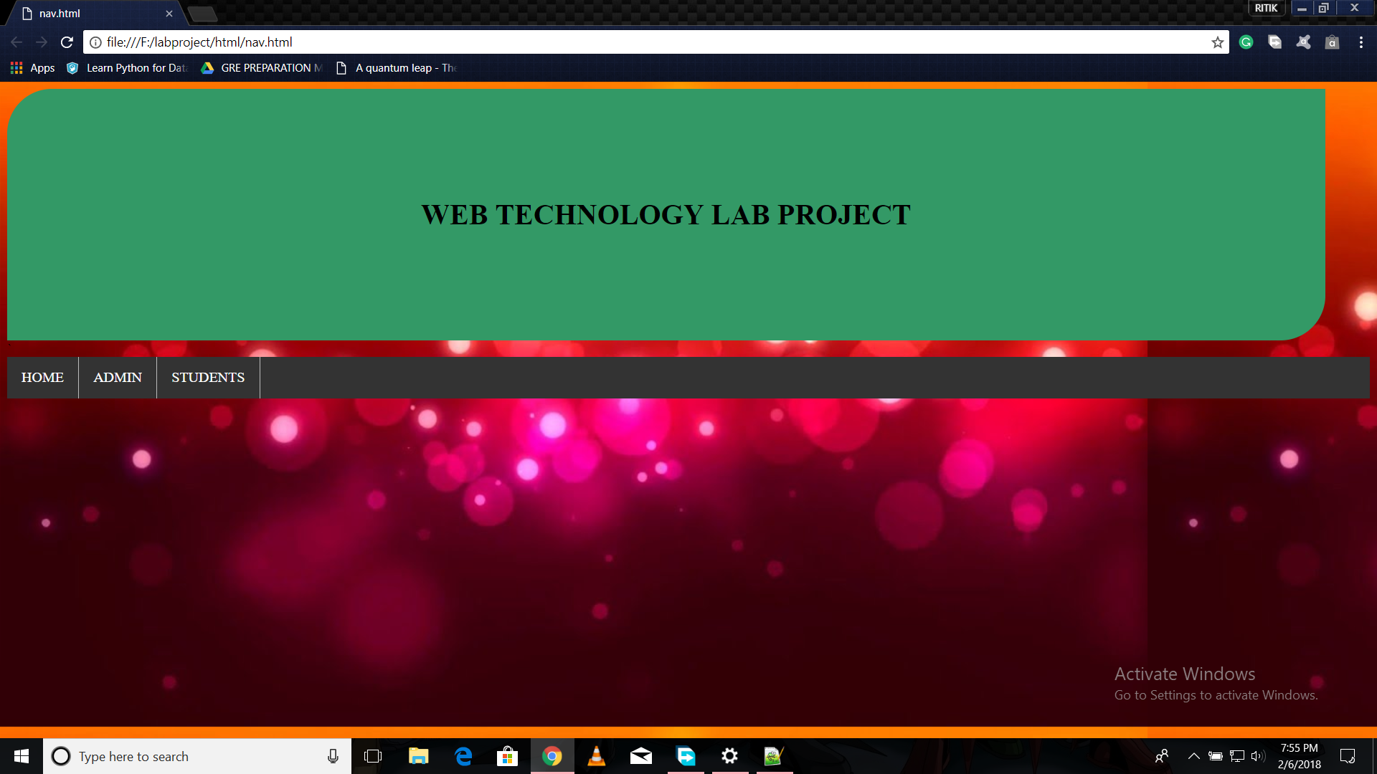
ADDING NAVIGATION BAR
WE ADDED A NAVIGATION BAR TO NAVIGATE BETWEEN THE PAGES ON TOP OF EVERY PAGE.

Slide 17
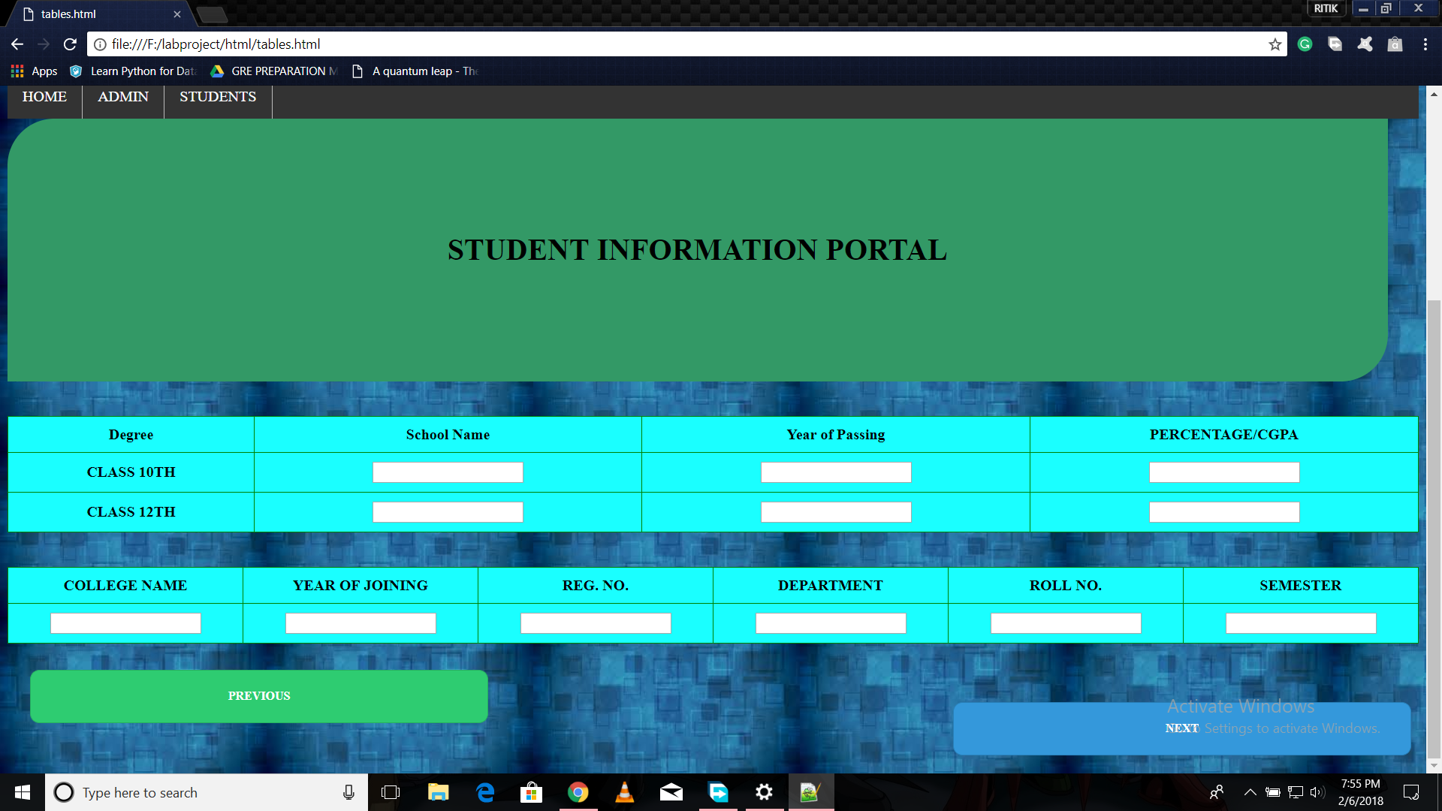
USING TABLES-
WE USED TABLES FOR TAKING INPUT FOR EDUCATIONAL QUALIFICATION.

Slide 18
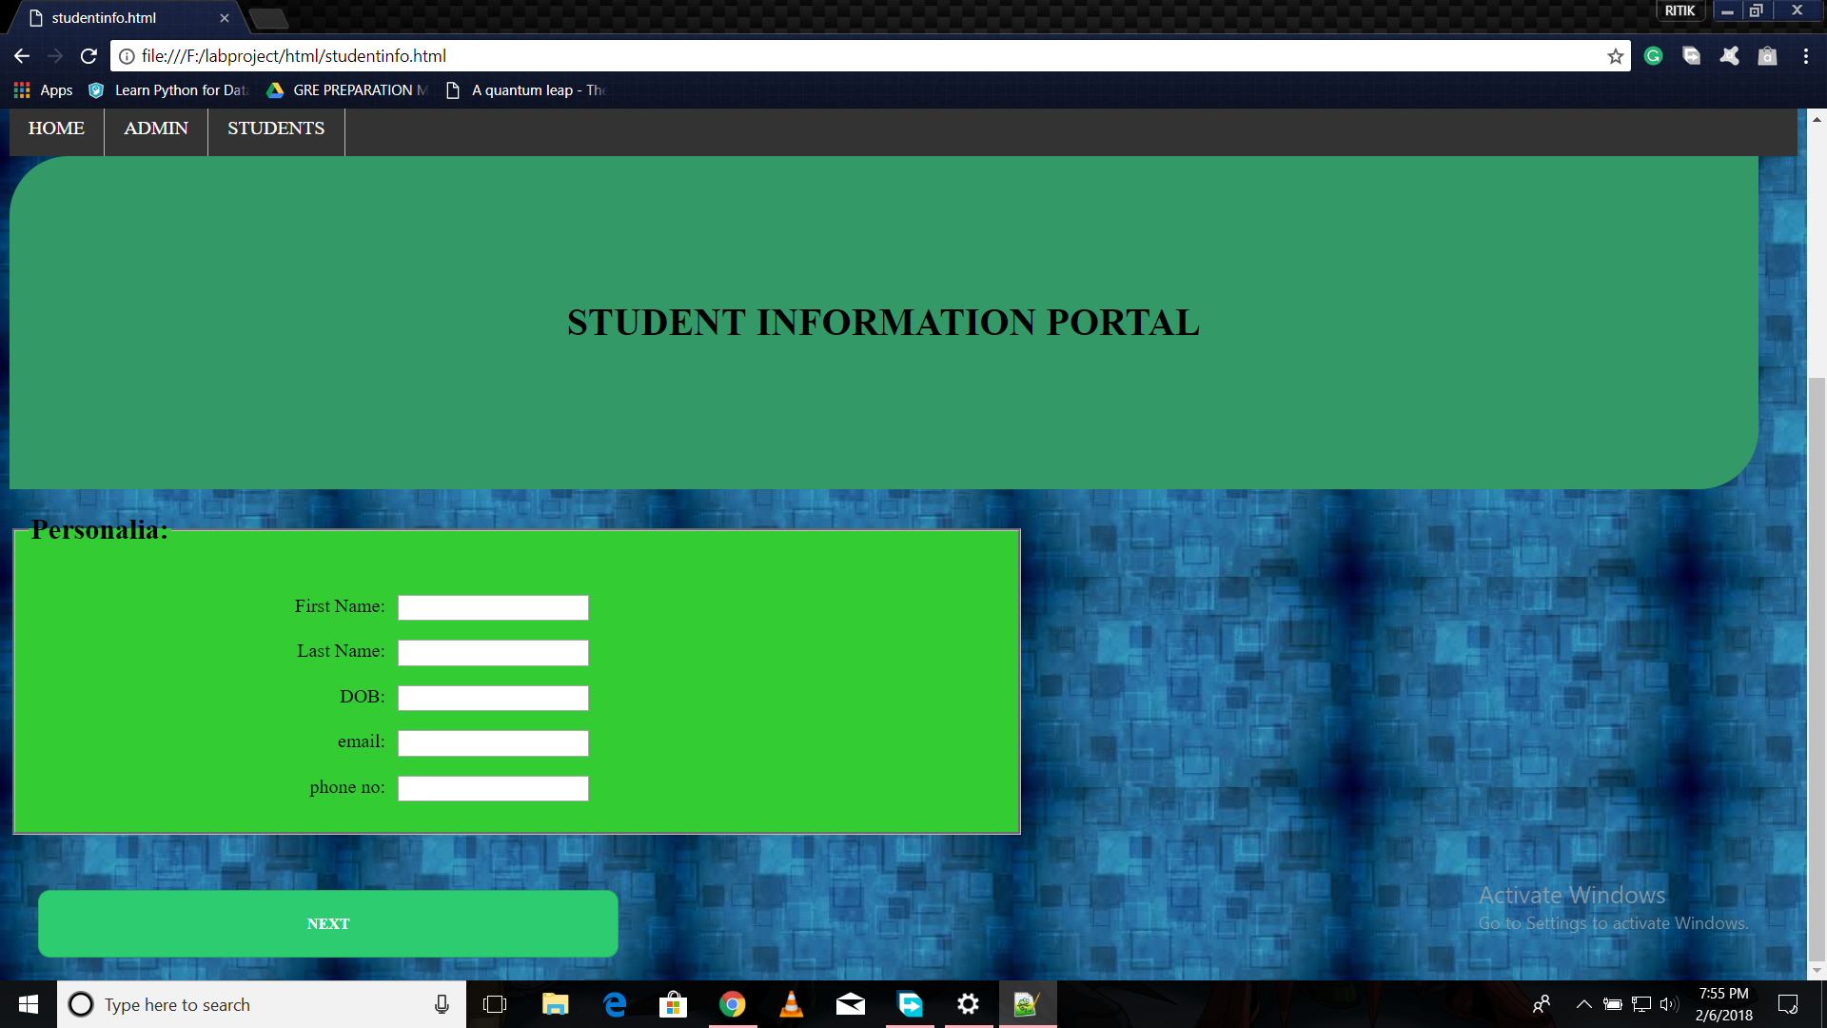
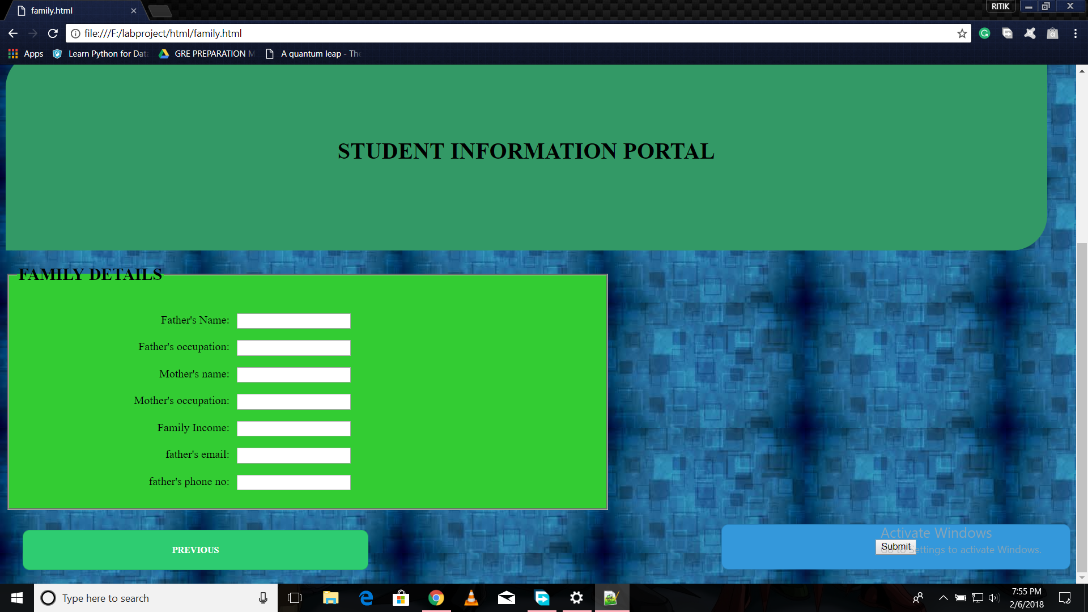
BREAKING FORM IN VARIOUS PAGES
WE BREAK FORM IN VARIOUS PAGES.

Slide 19
PLAN FOR NEXT LAB-
WE WILL VALIDATE ALL THE FORMS USING JAVASCRIPT.
WE WILL CONNECT OUR WEBPAGE WITH AN DATABASE.

